Slide 1
Tuturial for quantum-mechanical calculation
in GaussView 6.0

Slide 2
ENERGY, BOND LENGTH, DIPOLE MOMENT

Slide 3
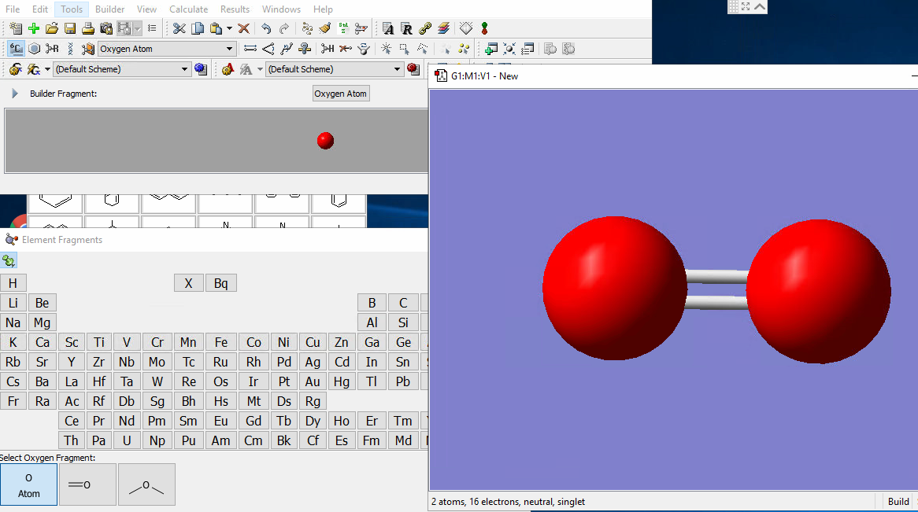
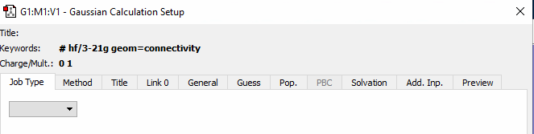
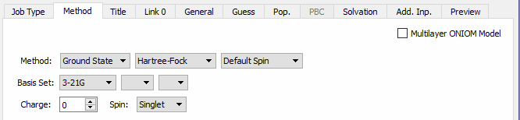
ENERGY, BOND LENGTH, DIPOLE MOMENT
O₂
create O₂ molecule
save the O₂ molecule as a Gaussian input file (.gjf)
use symmetrize button to optimize View window
read basic information about a molecule: number of electrons, state of an atom (is it singlet, doublet, triplet... ?)
optimize a molecule geometry: Open the Calculate menu/ Gaussian Calculations Setup (Ctrl+G)
set up following settings in Gaussian Calculations Setup window:
O
O
Job Type | - | Optimization
Method | Method | DFT Unrestricted B3LYP
Method | Basis Set | 6-31G (d )
Method | Spin | Triplet
NOTE:
DFT - one of the quantum mechanical method used in physics and chemistry to investigate the electronic structure
read Gaussian documentation:
http://gaussian.com/basissets/ and http://gaussian.com/dft/

Slide 4
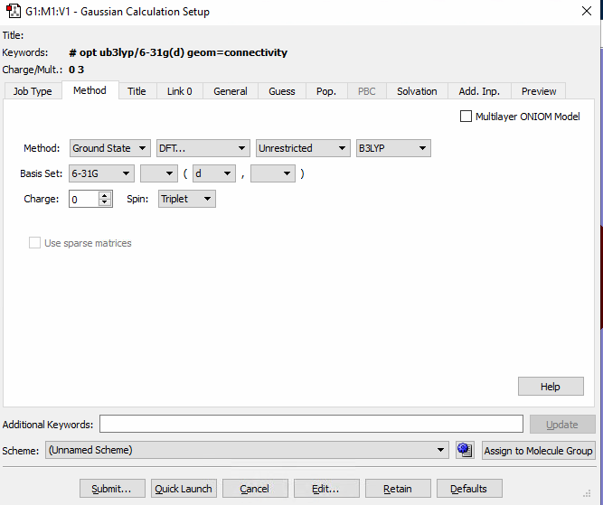
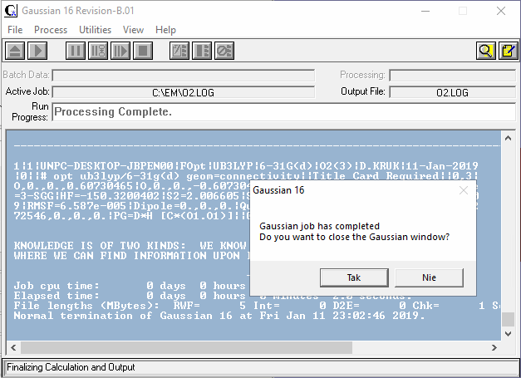
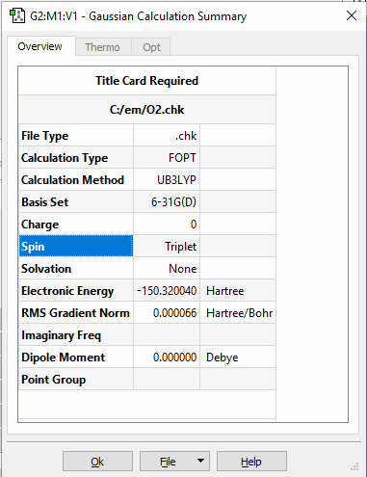
ENERGY, BOND LENGTH, DIPOLE MOMENT
O₂
Run the calculation: click „Submit” button
Choose „yes” to close the Gaussian window
When the calculation is complete, open the "chk" file: File/open/O2.chk (only when .chk file didn't open automatically)
Open Results menu/Summary
what is:
the value of Electronic Energy
the value of Dipole Moment
spin configuration?

Slide 5
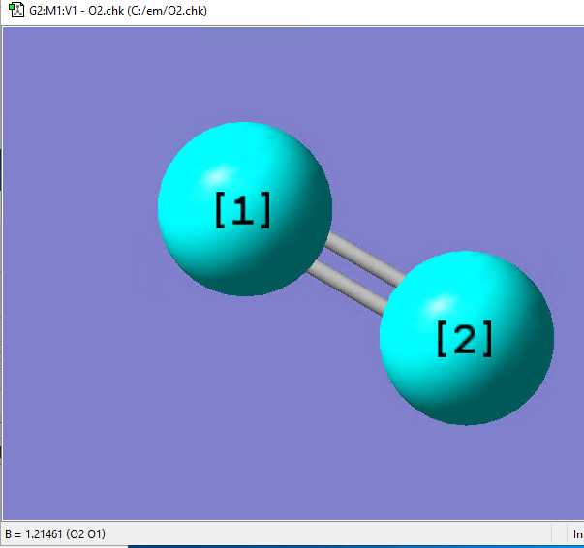
ENERGY, BOND LENGTH, DIPOLE MOMENT
O₂
measure the O=O bond length: click on the Inquire button on the Builder window
make atoms active and read bond length O=O It should be 1.215 Angstroms
repeat the O₂ calculation for the singlet state.
what is the value of Electronic Energy and singlet bond length?
the calculation results should show that the singlet bond length is 1.21594 Angstroms and the Electronic Energy is -150.257424 Hartree.
The Electronic Energy unit is [Hartree].
What is the difference of energy between these 2 spin states?
change unit for kJ/mol and eV, knowing that 1Hartree=2625.5 kJ/mol = 27.21 eV

Slide 6
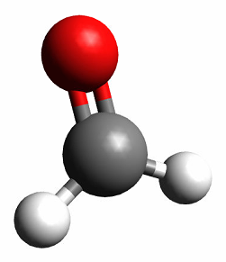
ENERGY, BOND LENGTH, DIPOLE MOMENT
CH₂O
O
Create CH₂O molecule
save CH₂O molecule as a .gjf
optimize View window
how many electrons has this molecule?
optimize a molecule geometry
set up following settings in Gaussian Calculations Setup window:
Run the calculation
read the value of Electronic Energy
express value of Electronic Energy in eV and kJ/mol
read the value of Dipole Moment
what is the unit of CH₂O Dipole Moment?
express value of Dipole Moment in [C*m], official unit in International System of Units. - knowing that 1 D = 3.33564·10^{–30} C·m
C
H
H
Job Type | - | Optimization
Method | Method | DFT Unrestricted APFD
Method | Basis Set | 6-311G Polarisation (2d, p )
Method | Spin | Singlet
NOTE:
Dipole Moment -The dipole moment is the first derivative of the energy with respect to an applied electric field. It is a measure of the asymmetry in the molecular charge distribution. It can be expressed as a vector.
read Gaussian documentation:
http://gaussian.com/basissets/ and http://gaussian.com/dft/

Slide 7
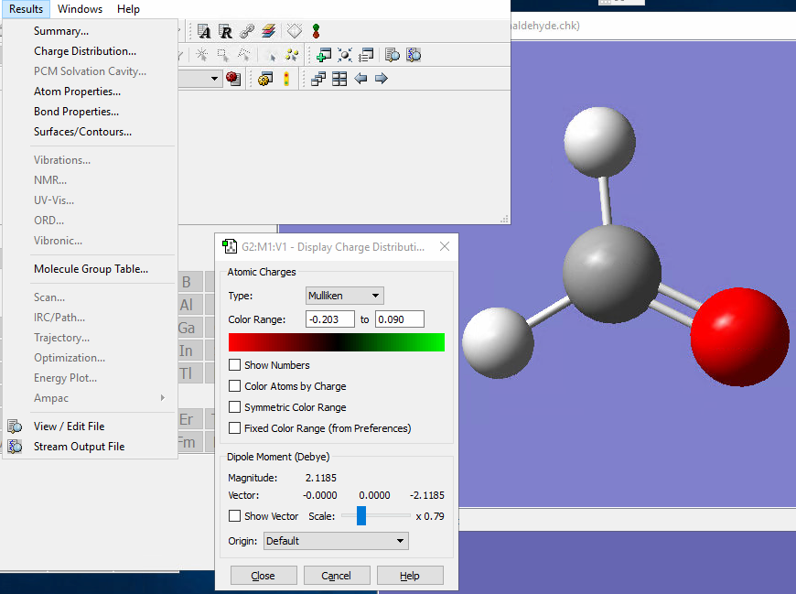
ENERGY, BOND LENGTH, DIPOLE MOMENT
CH₂O
Open Results menu/Charge Distribution

Slide 8
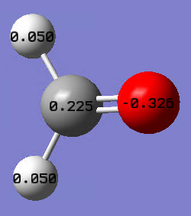
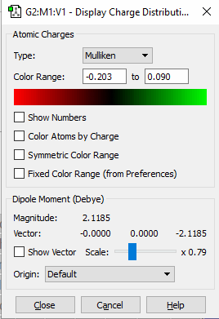
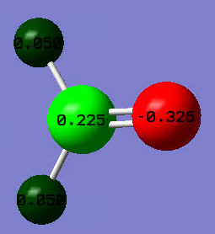
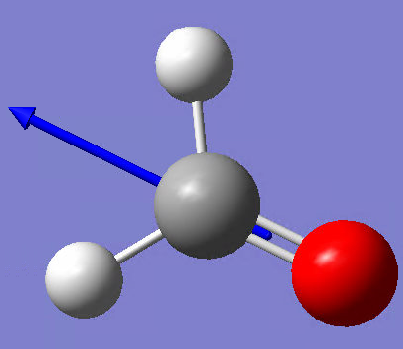
ENERGY, BOND LENGTH, DIPOLE MOMENT
CH₂O
Open Results menu/Charge Distribution
using default settings (Mulliken), check atomic Charge Distribution
click „Show Numbers” button - it shows the total charge among the atoms in the molecule
color also atoms by charge
click „Color Atoms by Charge” button
in the Dipole Moment section of the dialog,
click "Show Vector", to display a three-dimensional vector of molecular charge distribution

Slide 9
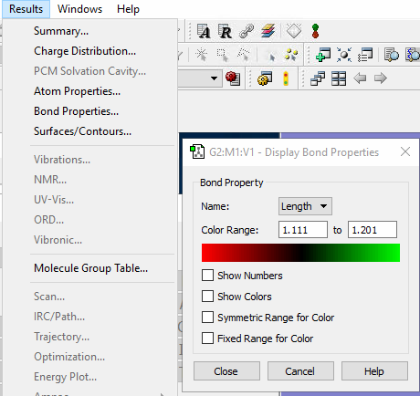
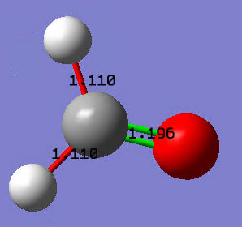
ENERGY, BOND LENGTH, DIPOLE MOMENT
CH₂O
O
measure the
O=C and C-H bond length, by using Inquire buton, like for O₂ molecule
note the both values
Open Results menu/Atom Properties
click „Show Numbers” button
click „Show Colors” button
Compare values from both methods
C
H
H

Slide 10
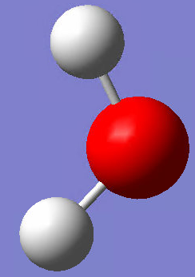
ENERGY, BOND LENGTH, DIPOLE MOMENT
H
H₂O
O
read the value of Electronic Energy
express value of Electronic Energy in eV and kJ/mol
read the value of Dipole Moment
express value of Dipole Moment in [C*m]
in Charge Distribution window
display the total charge among the atoms in the molecule
display the vector of Dipole Moment
measure the C-H bond length
Create H₂O molecule
save H₂O molecule
optimize View window
how many electrons has this molecule?
optimize a molecule geometry
set up following settings in Gaussian Calculations Setup window:
H
Job Type | - | Optimization
Method | Method | DFT Unrestricted B3LYP
Method | Basis Set | 6-31G Polarisation (d)
Method | Spin | Singlet
read Gaussian documentation:
http://gaussian.com/basissets/ and http://gaussian.com/dft/

Slide 11
CALCULATION OF THE VIBRATION FREQUENCY

Slide 12
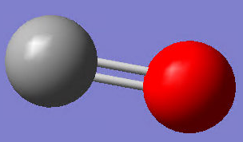
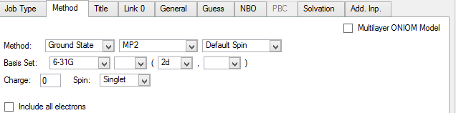
VIBRATION FREQUENCY
CO
C
read the value of Electronic Energy
express value of Electronic Energy in eV and kJ/mol
read the value of Dipole Moment
express value of Dipole Moment in [C*m]
in Charge Distribution window
display the total charge among the atoms in the molecule
display the vector of Dipole Moment
measure the C-O bond length
O
Create CO molecule
save CO molecule as a .gjf
optimize View window
how many electrons has this molecule?
optimize a molecular geometry and perform frequency calculations
set up following settings in Gaussian Calculations Setup window:
Job Type | - | Opt+Freq
Method | Method | MP2
Method | Basis Set | 6-31G Polarisation (2d)
read Gaussian documentation:
http://gaussian.com/basissets/ and http://gaussian.com/freq/

Slide 13
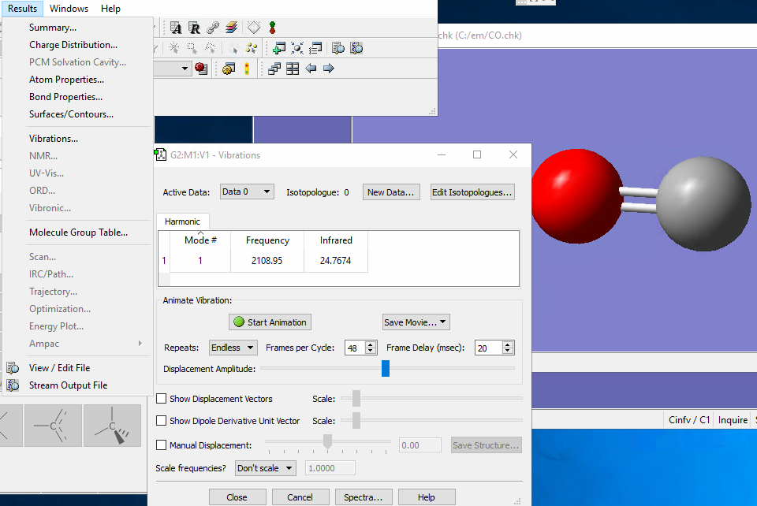
VIBRATION FREQUENCY
C
CO
O
Open Results menu/Vibrations
In Vibrations window click "start Animation"
play with Manual Displacement settings
measure the C=O bond length in 3 different positions
save movie file as a .gif
NOTE:
Frequency calculations take into account the nuclear vibrations in a molecular system in their equilibrium state. One of the examples of molecular properties is IR spectra (Infrared Spectroscopy) for the molecule.

Slide 14
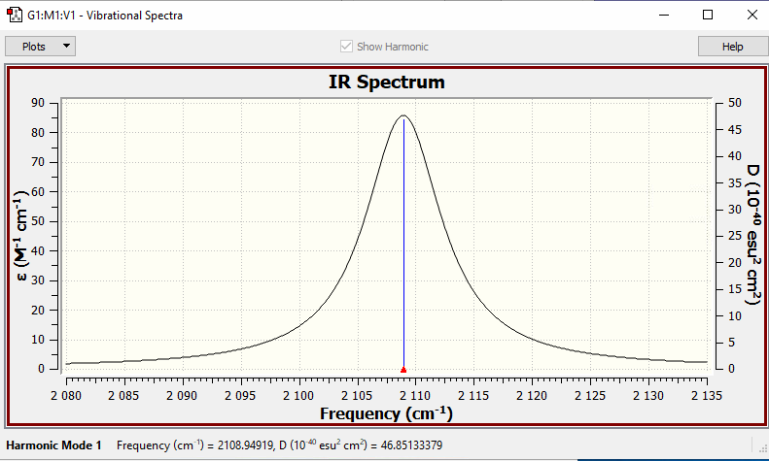
VIBRATION FREQUENCY
CO
Open Results menu/Vibrations
click "Spectrum" button to calculate IR spectrum

Slide 15
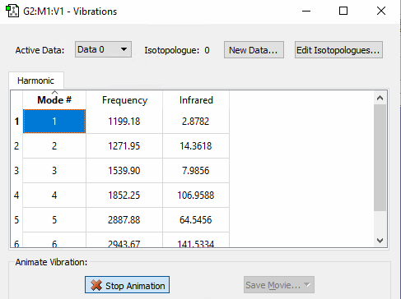
VIBRATION FREQUENCY
O
run the calculation
remember to work on .chk file
Open Results menu/Vibrations
In Vibrations window click "start Animation”
Select 1-6 Mode to observe type of molecular stretching
describe in your own words every type of molecular motion
CH₂O
C
Open CH₂O.gjf (formaldehyde) file
optimize a molecular geometry and perform frequency calculations
set up following settings in Gaussian Calculations Setup window:
H
H
Job Type | - | Opt+Freq
Method | Method | DFT Unrestricted APFD
Method | Basis Set | 6-311G Polarisation (2d, p )
Method | Spin | Singlet

Slide 16
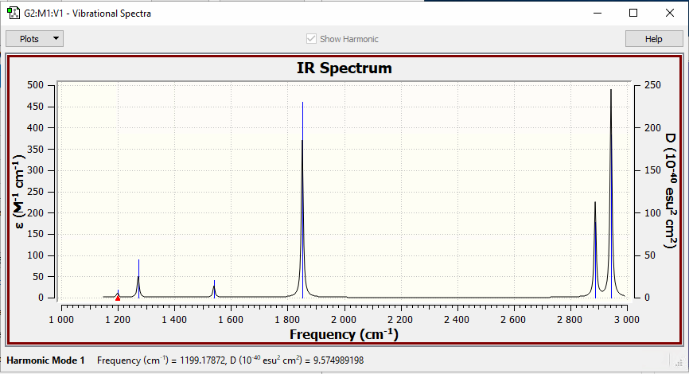
VIBRATION FREQUENCY
O
CH₂O
C
H
H
click "Spectrum" button to calculate IR spectrum
look again to "Vibrations" window
every type of Mode is related with a value of the frequency
Now look at the IR spectrum and learn the right name of every type of motion, which you've seen before
C=H stretch
C-H asymmetric stretch
CH₂ rock (in plane)
CH₂ wag (out-of-plane)
CH₂ scissors (in plane)
C-H symmetric stretch

Slide 17
MOLECULAR ORBITALS

Slide 18
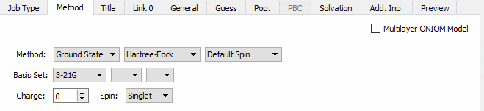
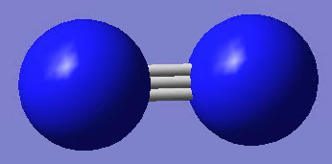
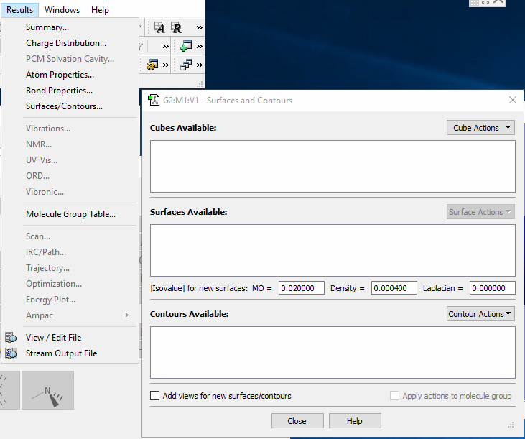
MOLECULAR ORBITALS
N₂
N
N
create N₂ molecule
save the N₂ molecule as a .gjf
optimize View window
perform Energy calculations
set up following settings in Gaussian Calculations Setup window:
Submit the job
Electronic Energy = ?
To view molecular orbitals, open Results menu /Surfaces/Contours
Job Type | - | Energy
Method | Method | Hartree-Fock
Method | Basis Set | 3-21G
read Gaussian documentation:
http://gaussian.com/basissets/

Slide 19
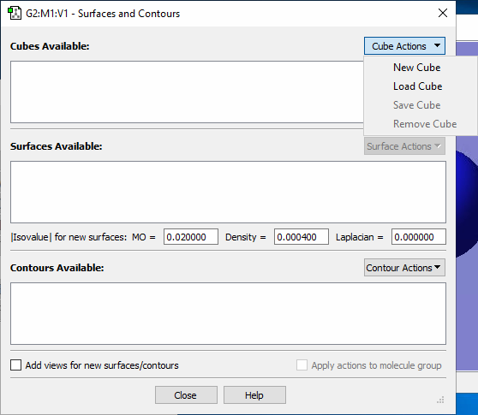
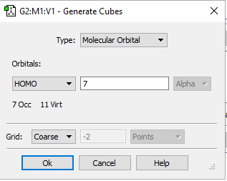
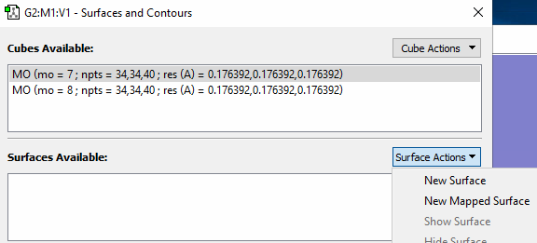
MOLECULAR ORBITALS
N₂
N
N
click "Cube Action"/New Cube
In the Generate Cube window, choose
Type: Molecular Orbital
Orbitals: HOMO (orbital number 7)
the HOMO MO 7, will be added to the list of available cubes.
create the cube for the LUMO, MO 8
NOTE:
The Molecular Orbital is a mathematical function which describes the behavior of an electron or pair of electrons within a molecule. It can be expressed as a surface around the molecular structure.
The highest occupied molecular orbital, HOMO and the lowest unoccupied molecular orbital, LUMO, may be identified by finding the point where the orbital occupied changes from occupancy to unoccupied.

Slide 20
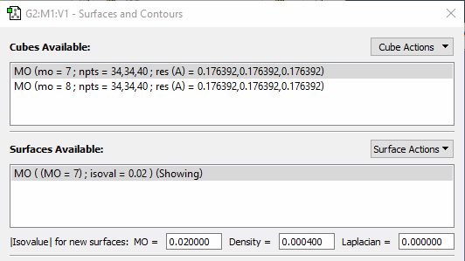
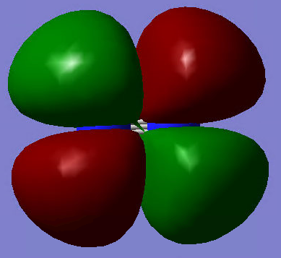
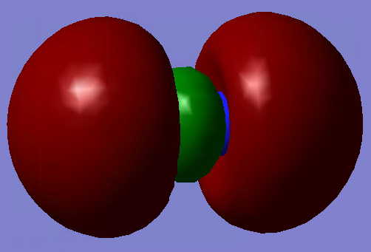
MOLECULAR ORBITALS
N₂
N
N
Select (click on) one of the available cubes in "Cube Available window" and click "Surface Action"/New Action
MO 7/8 will appear in the Surfaces Available list and will appear in the View window.
LUMO
HOMO

Slide 21
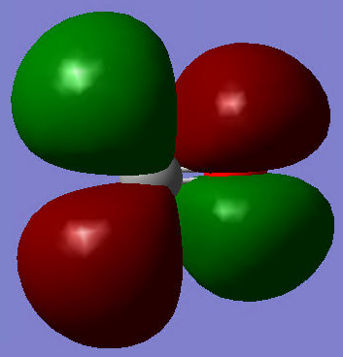
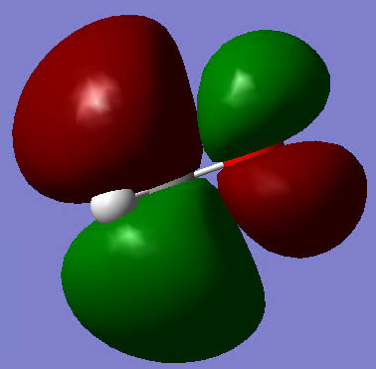
VIBRATION FREQUENCY
O
click "Cube Action"/New Cube
In the Generate Cube window, choose
Type: Molecular Orbital
Orbitals: HOMO 8 and LUMO 9
create New Surfaces for both cases
CH₂O
C
Open CH₂O.gjf (formaldehyde) file
optimize View window
perform Energy calculations
Set up following settings in Gaussian Calculations Setup window:
Submit the job
Electronic Energy = ?
To view molecular orbitals, open Results menu /Surfaces/Contours
H
H
Job Type | - | Energy
Method | Method | DFT Unrestricted APFD
Method | Basis Set | 6-311G Polarisation (2d, p )
HOMO
LUMO

Slide 22
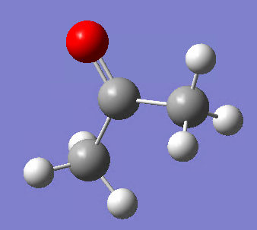
EXERCISE:
(CH₃)₂CO
O
H
C
C
based on the tutorial, try to repeat all the steps to analyze the Acetone molecule and compare results with Formaldehyde molecule
perform all calculations using chemistry model with the following settings in Gaussian Calculations Setup window
try to find in literature (or on the internet) the IR spectrum of acetone and compare it with this which you obtained from simulations
H
H
C
H
H
Job Type | - | Optimization, Opt+Freq and Energy
Method | Method | DFT Unrestricted APFD
Method | Basis Set | 6-311G Polarisation (2d, p )
Method | Spin | Singlet

